Slide 1
COVID-19 Vaccination Distribution in the U.S
Dang Khoa Do

Slide 2
Project Topic and Dataset
Topic
For the final project topic, COVID-19 vaccination is helping people in the U.S to fight back the pandemic. Therefore, I want to analyze the COVID-19 vaccine distribution in the USA from 2021 to 2022 to see the trend of the vaccination distribution and the real situation of the vaccination based on the vaccination rate in the U.S.
Dataset
Link for the dataset:
Vaccination distribution: https://ourworldindata.org/us-states-vaccinations.
The U.S population: https://www.kaggle.com/datasets/alexandrepetit881234/us-population-by-state?resource=download&select=us_pop_by_state.csv
The dataset is from kaggle.com which represents the vaccine for COVID-19 that is available in the USA. Also, the dataset also provides state-by-state data on COVID-19 vaccinations in the U.S. The dataset has 16 columns and 42981 rows.
The dataset is updated daily, so it is up-to-date and the data is recent. The source of data is reliable and transparent.

Slide 3
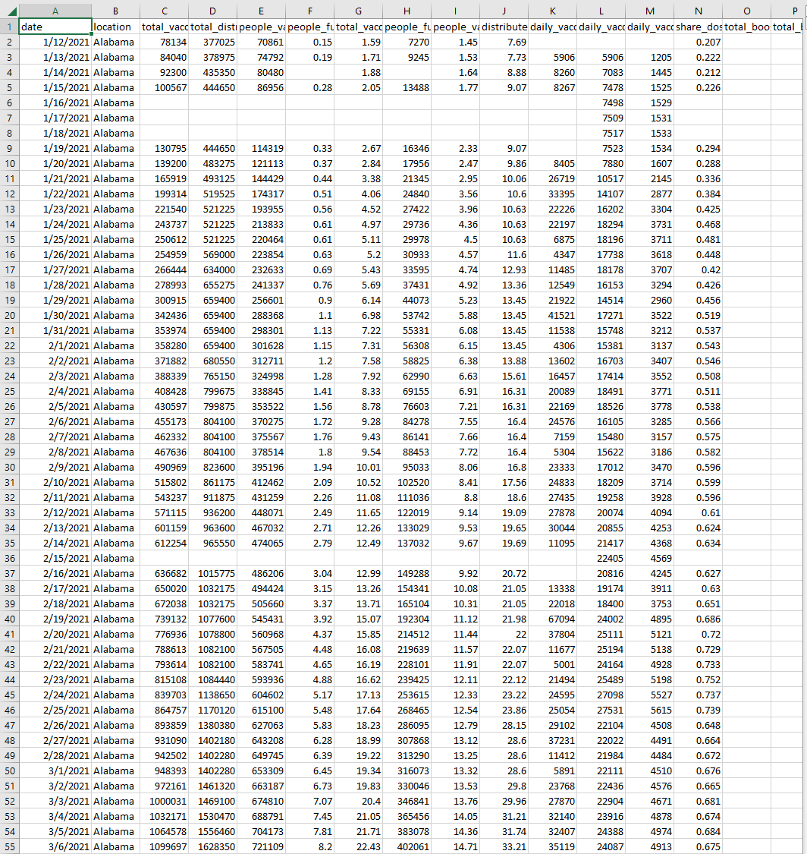

Slide 4
Questions
These are some questions that the result of the data analysis will attempt to answer to have insight into the vaccination campaign in the United States, so we can see the people’s concern about the COVID-19 pandemic.
How is the different vaccination distribution between states?
Which state has the highest and lowest total vaccination?
Is the people fully vaccination which is affected by other aspects?
How the rate of people who fully vaccination in the future?
What is the amount of people get vaccine daily now and in the future?
How is the booster vaccination amount change between 2021- 2022?

Slide 5
Data Analysis Process and Problems
Data Analysis Process and Tools
Clean the dataset by keeping 50 States of the U.S and remove some other territories
Analyze data using tools such as python and Power BI
Visualization of the dataset using tools such as Tableau, Power BI
Prediction future trends of vaccination using Python and Power BI
Problems and Solution
The data is updated by time so I cannot delete the NaN value for the whole dataset because the data will be lost. Therefore, I created the data frames and delete the NaN for each column and when it needs for analysis.
It is hard to detect the outlier and error in the dataset because the data is not continuous. I use the statistic summarize to understand more about the data and detect the error.
For some data, using Power BI is not suitable for showing data. Using the multiple tools such as Python, Tableau and Power BI will help create the data better.

Slide 6
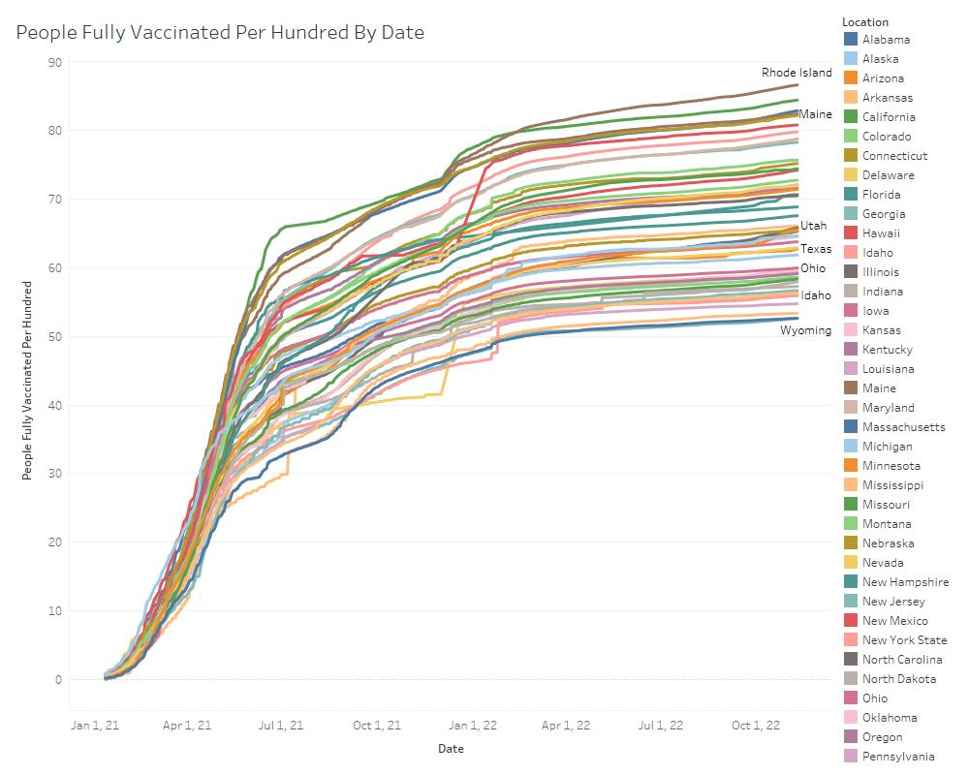
The rate of people complete the vaccine protocol

Slide 7
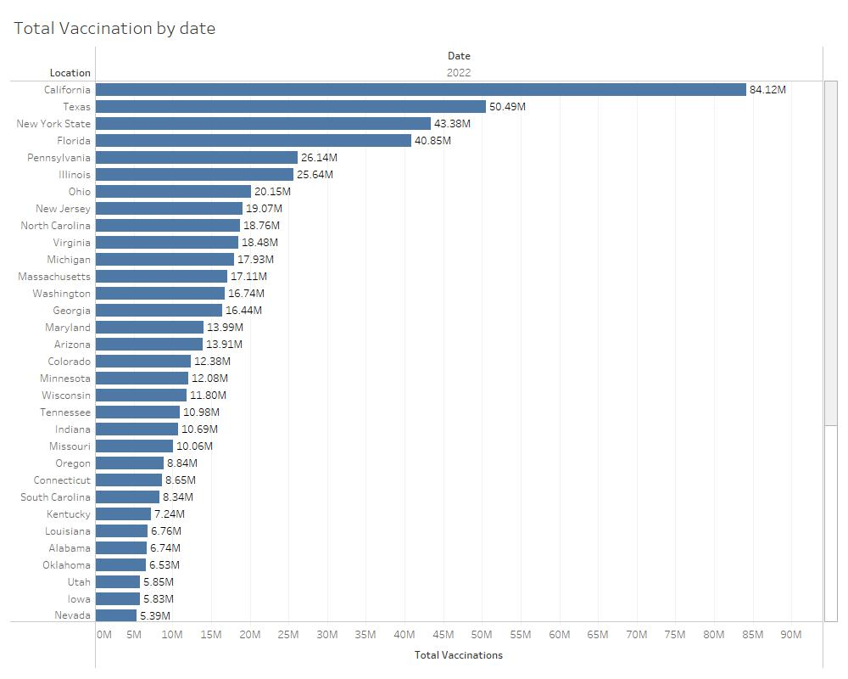
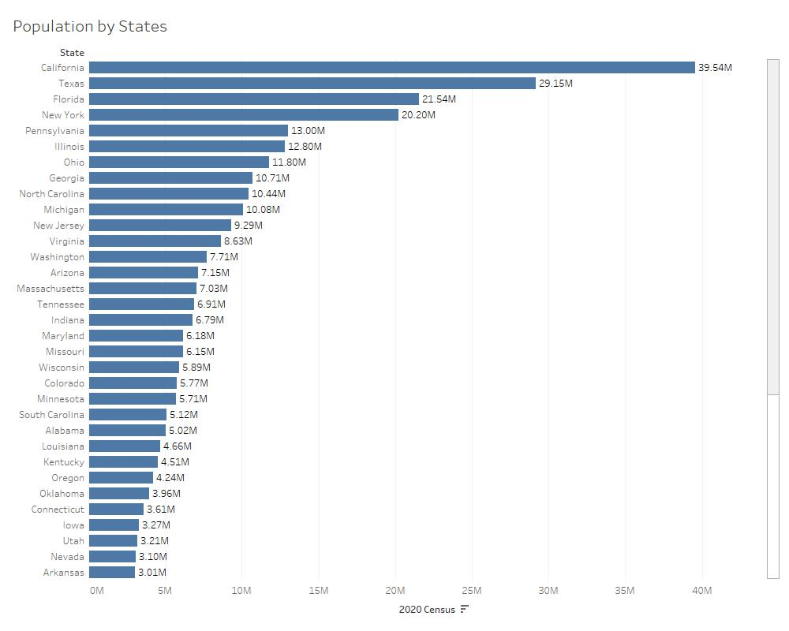
The different total vaccination between States in 2021- 2022

Slide 8
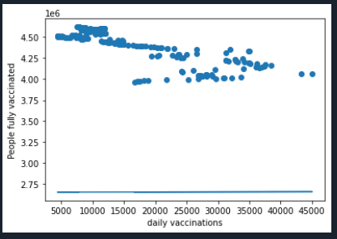
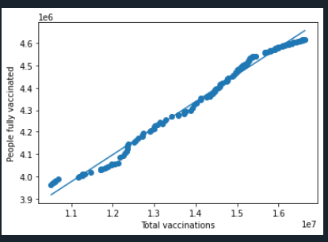
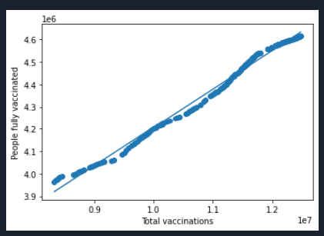
The people fully vaccination and other aspects
Regression analysis
Dependent variable:
Y = people fully vaccinated
Independent variable:
X1 = Total vaccination
X2 = daily vaccination,
X3 = total distributed
Model 2: Y as a function of X2
R square = 0.6537
Model 3: Y as a function of X3
R square = 0.988
Model 1: Y as a function of X1
Intercept: 2495736.322
Coef: 0.17122
R square = 0.991
Model 12: Y as a function of X12
R square = 0.9957
Model 123: Y as a function of X123
R square = 0.9957

Slide 9
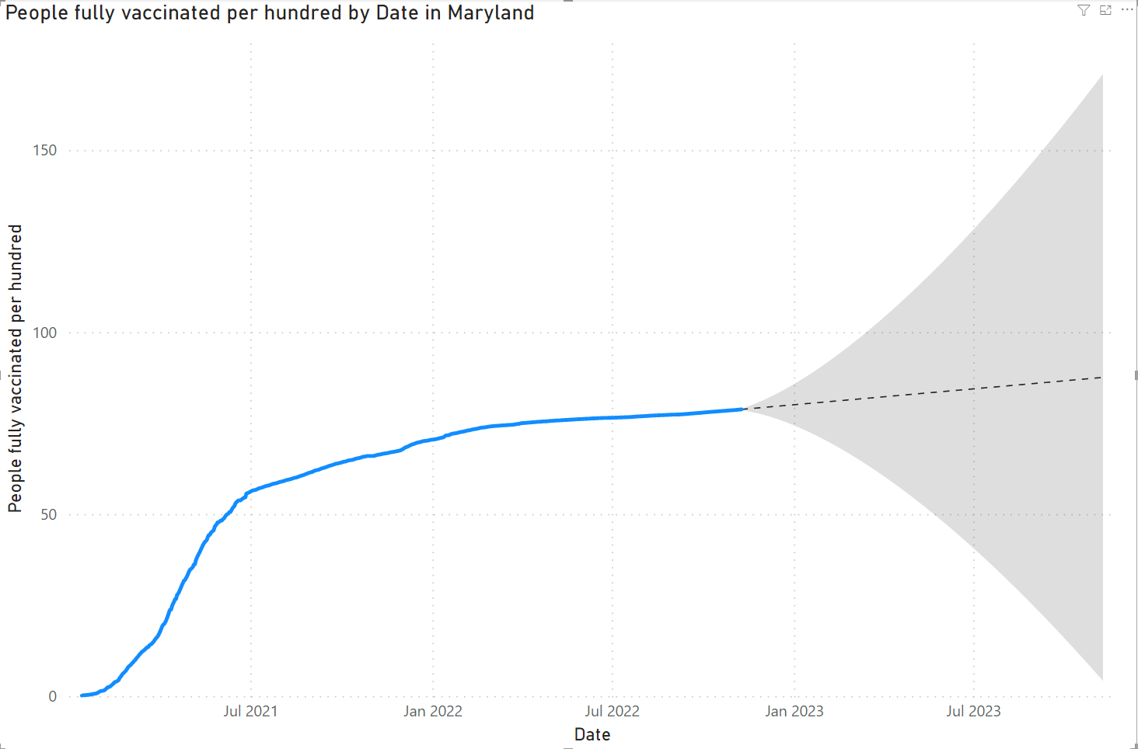
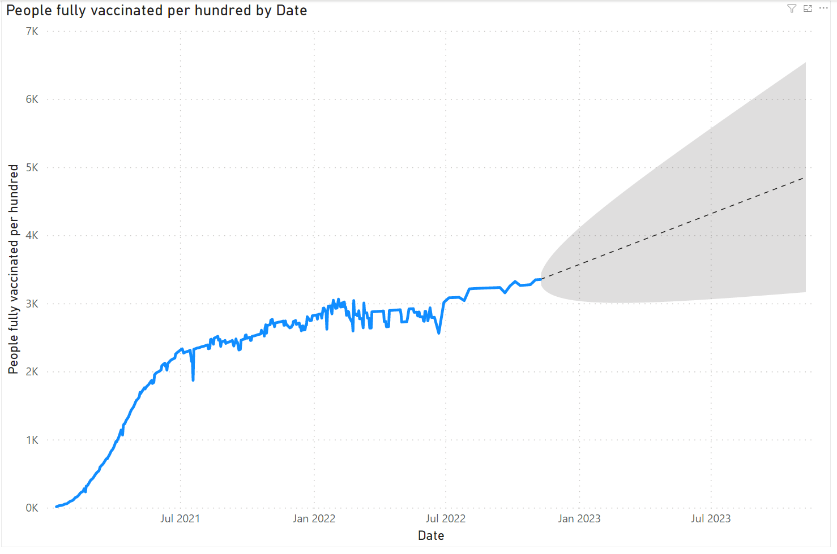
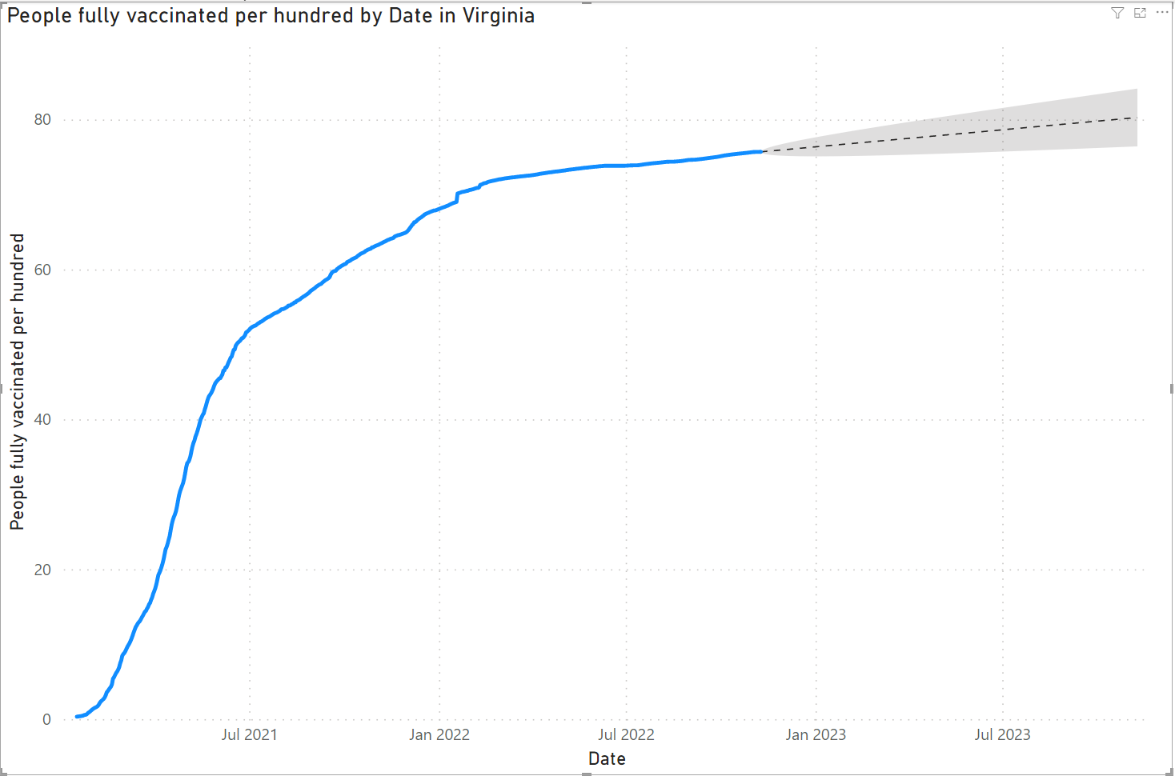
The rate of people fully vaccination in the future

Slide 10
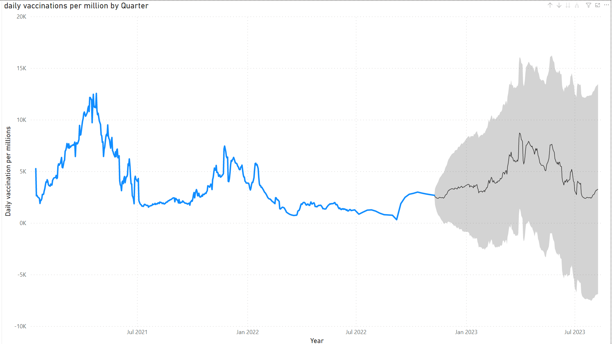
The rate of people get daily vaccination in the future
The forecast predict the daily vaccination will be a little bit higher than 2022.
The chart shows the pattern of daily vaccination that the amount of daily vaccination will be higher from January to April.

Slide 11
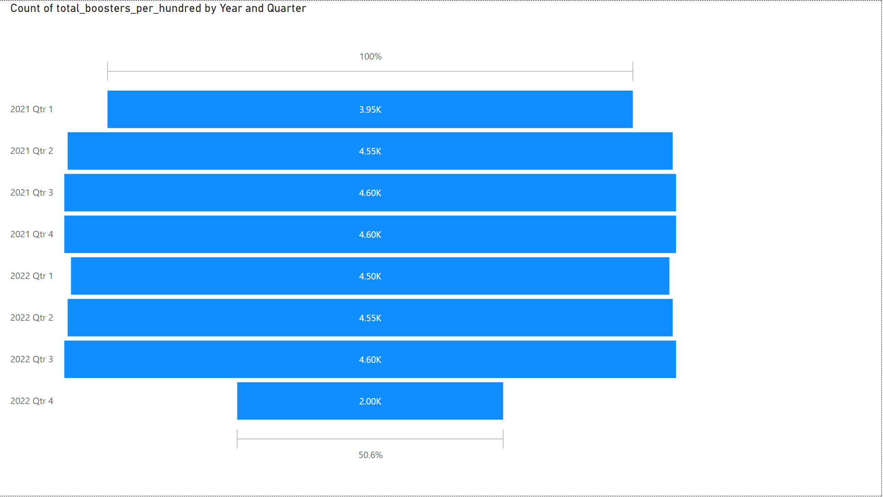
The change of vaccination booster in 2021 - 2022
The vaccination booster is increasing from Quarter 1, 2021 and keep steady to Quarter 3, 2022.
However, the rate is drop 50% in the Quarter 4, 2022.

Slide 12
Result
From the data visualization and data analysis:
All most of the states are doing the vaccination protocol very. The percentage of people finish the protocol is over 50% and keep continuing to rising in the future.
California has the highest total vaccination and Wyoming has the lowest total vaccination.
As the result of the regression analysis, the amount of people fully vaccination is affected by the total vaccination and total distribution. It is not affected by daily vaccination rate.
The total of people fully vaccination still increase in the future based on the forecast tools. The chart also show people get more vaccine in the cold weather months and the rate is slow down in the warm weather months.
The booster vaccination is decreasing as 50% now, so people stop taking the booster. It can be the reason is the booster is for elders or people do not have too much concern about COVID-19

Slide 13
Thank you!
Any Question?

